Slide 1

MALIGNANT COMMENTS CLASSIFICATION PROJECT
Submitted by:
Mrs. CHAITALI M. NAKADE
Hnh

Slide 2

Agenda
Introduction
Problem statement
Tools used
About dataset
Data sources and there format
Data preprocessing
Outlier and skewness removal
Model building
Select best model
Hyperparameter tuning
conclusion

Slide 3
Introduction
Now a days social media is a highest priority.
Comments on any social post is just like a trend.
Individuals are expressing their opinions/feelings with comments
But sometimes peoples are getting angry in it, like they are posting a bad, malignant, abusive, threatening comments due to that other are getting embraced and uncomfortable.
Online hate, described as abusive language, aggression, cyberbullying, hatefulness and many others has been identified as a major threat on online social media platforms.

Slide 4
Problem statement
Our goal is to build a prototype of online hate and abuse comment classifier which can used to classify hate and offensive comments so that it can be controlled and restricted from spreading hatred and cyberbullying.
There are two data set 1st one is train dataset and other is test dataset
Model Building phase:
Data Cleaning
b) Exploratory Data Analysis
c) Data Pre-processing
d) Model Building
e) Model Evaluation
f) Selecting the best mode

Slide 5
Tools used
Hardware and Software Requirements and Tools Used
Notebook and Data:
GitHub, Jupyter Notebook
Libraries:
Numpy
Pandas
Sklearn
Scipy
Joblib
Matplotlib
Seaborn
statsmodels

Slide 6
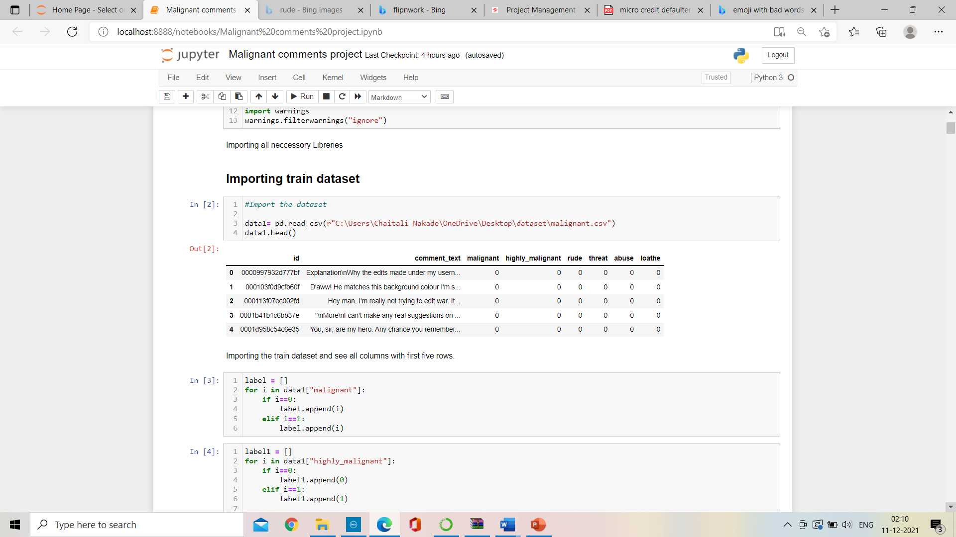
About dataset
The train dataset contains 159571 rows 8 columns and test dataset contains 153164 and 2 columns
Importing necessary libraries
After importing dataset the dataset will be look like,

Slide 7
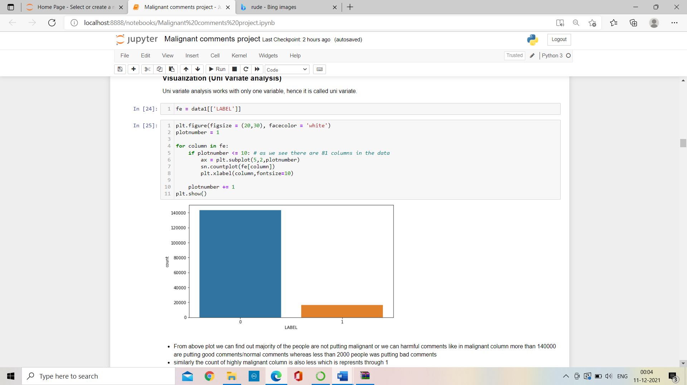
Data sources and there format
We can see there are no null values present in whole dataset.
We can find here six columns are having object data types and rest two columns are having integer datatype.
Target column:
Majority of comments are non-malignant
in nature with 140000 above
peak and less than
2000 are malignant in nature

Slide 8
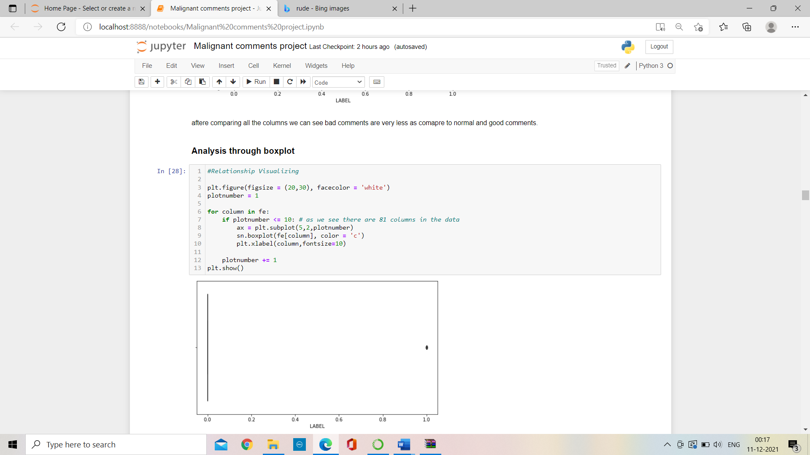
Data sources and there format continue..
We can see there is outliers are present in target column but no need to treat that.

Slide 9
Data preprocessing
Block diagram of data preprocessing
1.Drop unnecessary columns
2.Filling missing value
3.Encode the object datatype
4.Outlier detection
5.Skewness removal

Slide 10
Outlier and skewness removal
In this dataset we don’t have any missing value.
Drop that columns which are having poor correlation with target variable.
Encode the object datatypes columns with label encoder.
Use that technique outlier removal technique through which less data will be loss.
But outliers are not present in it
For continuous columns which are having skewness value greater than +0.5 to -0.5 then it is important to remove skewness from that.

Slide 11

Model building

Slide 12
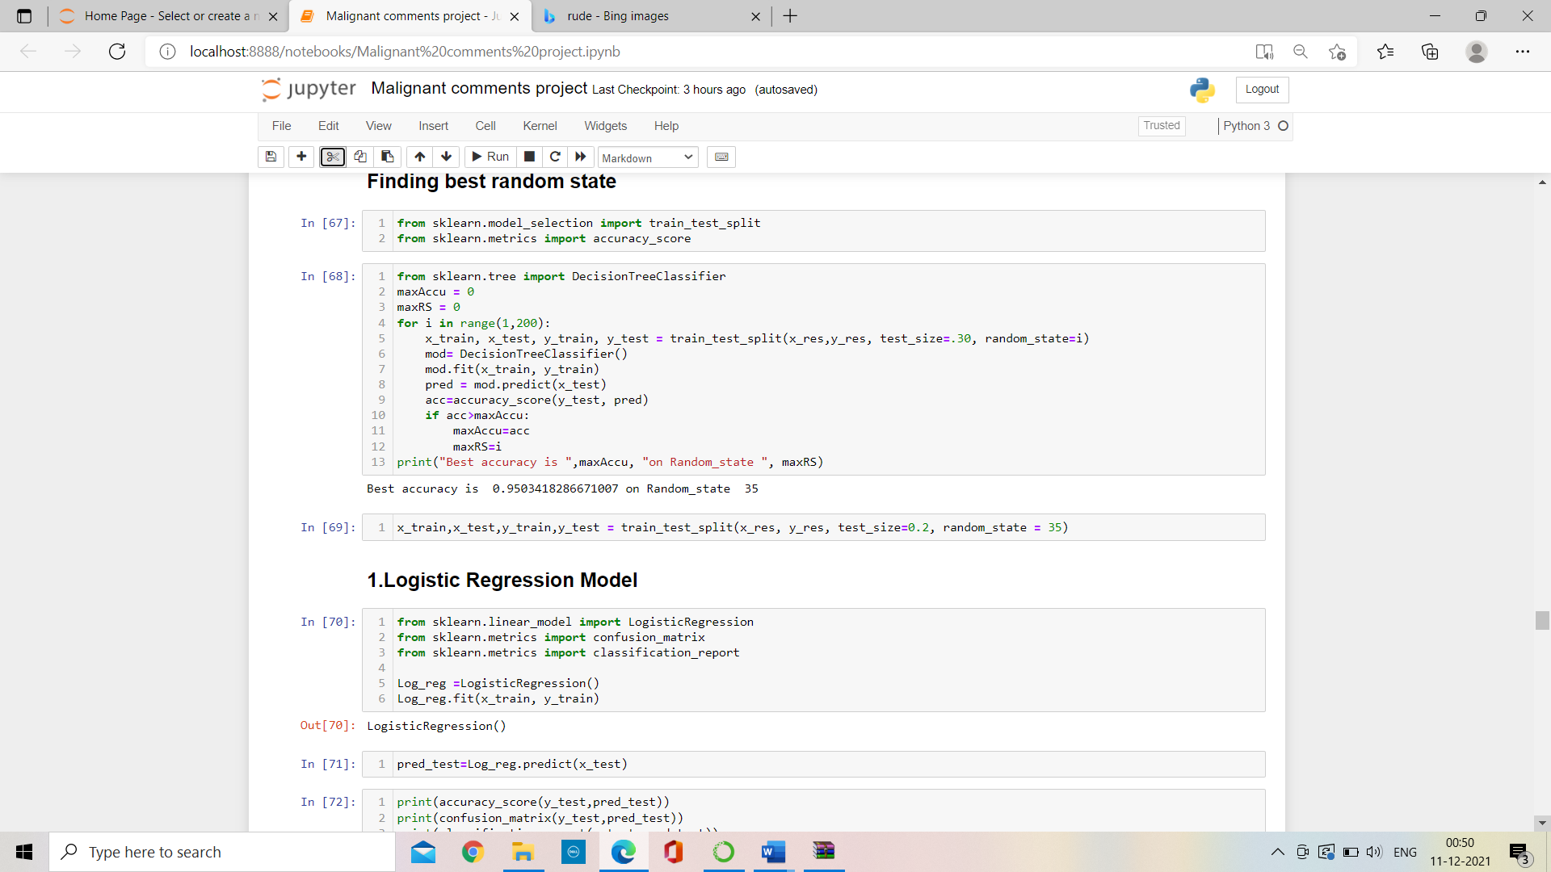
Model building
Find best random state
k
Train test split
Model building
R2 score
According to output best random state is 35 with 95.03% best accuracy.
Cross validation score

Slide 13
Model Building
Find best random state
Train test split
Model building
Train test splitting of data with best random state.
R2 score
Cross validation score

Slide 14
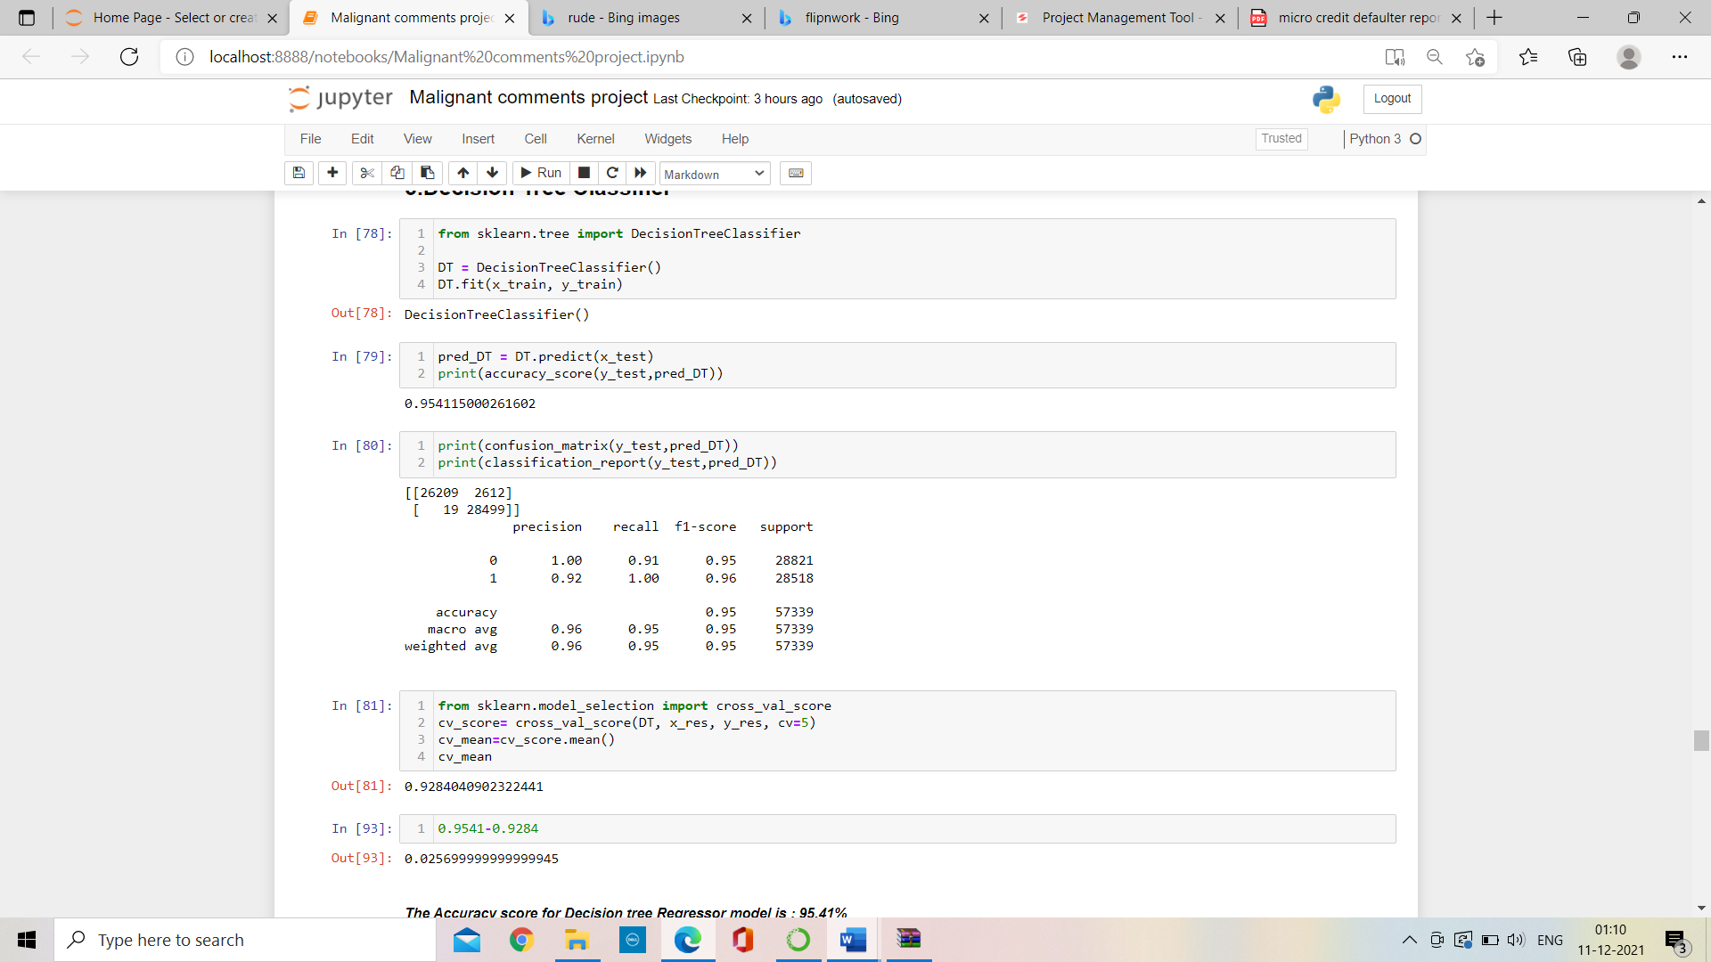
Find best random state
Train test split
Model building
R2 score
We get 95.41% accuracy after using decision tree classifier algorithm
Cross validation score

Slide 15
Selecting best model
Comparison of models
Decision tree classifier model is having minimum difference between cross validation score and accuracy score, so Decision tree classifier is a best model.
Sr. No. | Algorithms | Accuracy score (a) | Cross -Validation Score(b) | Difference (a-b)
1. | Logistic regressor | 82.89% | 44.51% | 5.03 %
2. | Random Forest classifier | 96.75% | 93.67% | 3.07%
3. | Decision Tree Classifier | 95.41% | 92.84% | 2.56%
4. | KNeighbors Classifier | 89.49% | 85.04% | 4.46%

Slide 16
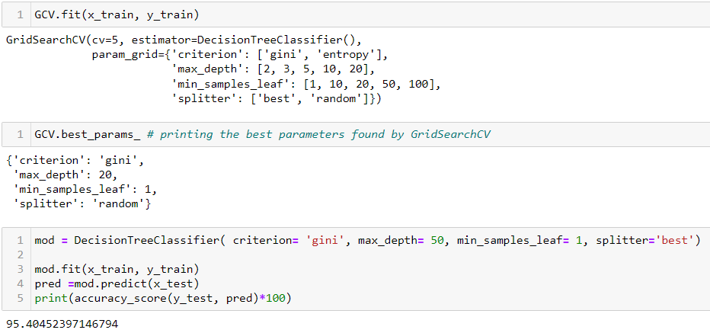
Hyperparameter tuning
Grid search cross validation (GCV) in hyperparameter tuning will help us to finding the best parameter and tune it with training data set and give best accuracy score
After hyperparameter tuning the accuracy score is remain to : 95.40%

Slide 17
Conclusion
As we see our model is having minimum difference between accuracy score and cross validation score. So, decision tree Classifier is best model with accuracy score is: 95.41%
We fit our training data into the hyperparameter tunning model and check for accuracy .
We got an accuracy of 95.40% which is amazing.

Slide 18
Thank You

